Slide 1

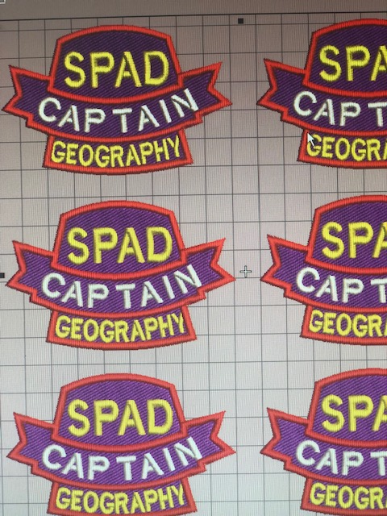
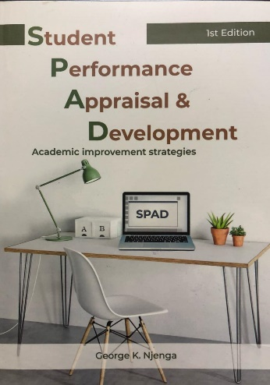
SPAD
Student Performance Appraisal and Development
PRESENTED BY
KEPHA mariera
A Candle Loses Nothing By Lighting Another

Slide 2
Defining Characteristics of Generation Z IS:-
financially focused
entrepreneurial
all about technology
enjoys other people
competitive
Change is welcomed
Diversity doesn’t even register with
prefers independence
wants to be heard
can be a lot like their parents

Slide 3
Generation Z Facts & Characteristics
technologically advanced - Social media-addicted
have never seen the world without the internet
they absorb tons of new information every day.
They perceive information visually, sight and sound generation
Being independent, self-confident and autonomous. They do not rely on their parents as much as previous teen generations did.
They short attention spans and are less focused than their predecessors.
They are environmentally aware.
Multitasking is also one of the positive generation Z traits.

Slide 4
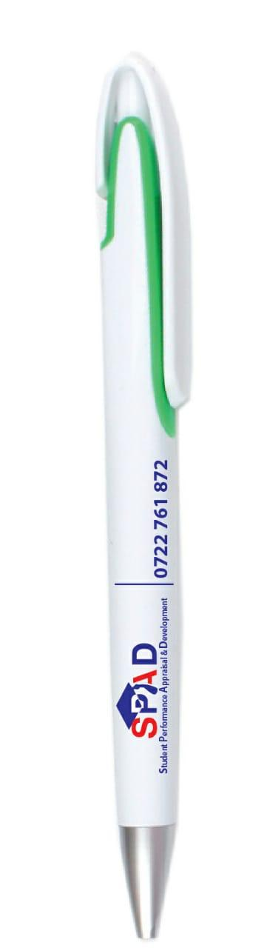
There is a missing piece. There are four pieces
Parenting.
Technology.
Impatience.
Environment.

Slide 5
The ongoing Silent but Lethal Generational Conflict
There is serious generation gap where Generation Y (1984 – 1996) is missing in school leadership.
The worse bit is that Baby boomers (1946 – 1964) are handling Generation Z (1997-2014).
The negative effects of Baby Boomers and Generation X (1965-1983) is they demonize technology especially the mobile phone. This unknowing declaring conflict with generation Z
The Spad model aims at reducing the generational gap for generation Z by involving the students in the academic process.

Slide 6
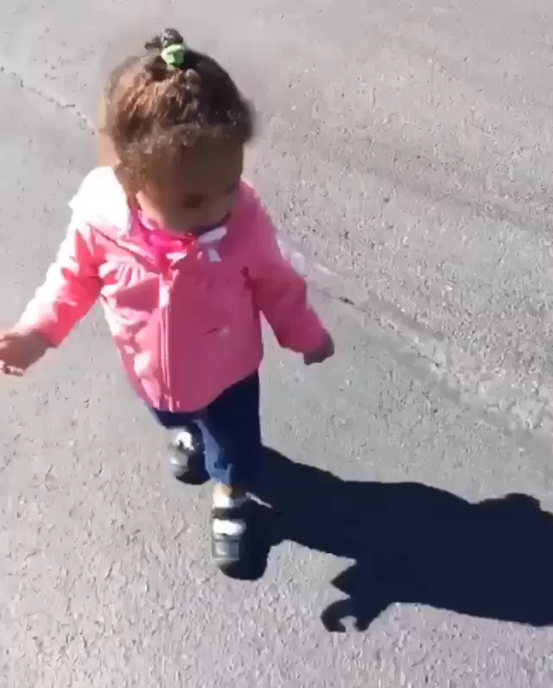
We can’t escape our character
Our performance will always follow us

Slide 7



Transformational speaker
ACADEMIC IMPROVEMENT STRATEGIES (SPAD)
Presented by
Kepha Mariera
BED (Hons). Egerton University
Teacher (MOI FORCES ACADEMY)
MASTERS Egerton uni (EDUCATION ADMINISTRATION)
MOTIVATIONAL SPEAKING
1. Exam
2. final class

Slide 8
WHAT IS
As T-PAD is to Teachers, so is S-PAD to Students

Slide 9
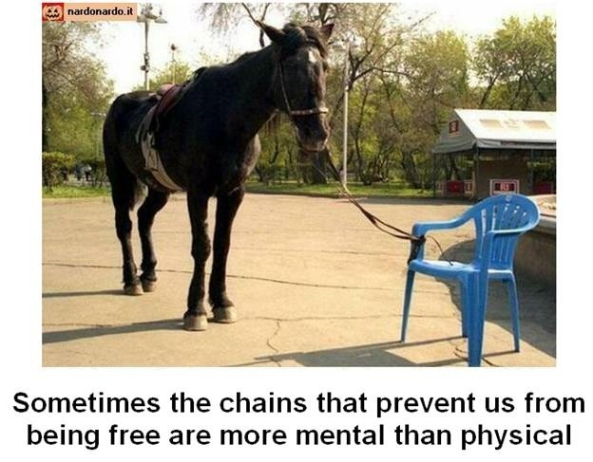
SPAD UNLEASHES OUR POTENTIAL
STUDENT
ATTITUDE

Slide 10


Slide 11


Slide 12


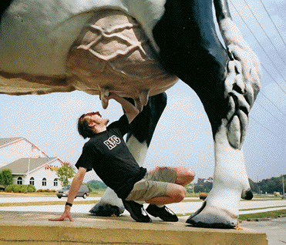
Pareto's Principle - The 20-80 Rule
SUCKERS AT SCOOL
SPOON FEEDING STUDENTS
THE JOY RIDERS IN CLASS

Slide 13

THE TPAD IS TIP OF THE ICE BERG
HOW MUCH OF AN ICEBERG DO YOU SEE ?
THE TIP OF THE ICEBERG

Slide 14

SMALL PART OF ICEBERG IS VISIBLE.
THE REMAINING IS BELOW SEA LEVEL.
THE TPAD
THE SPAD
To make grand and attainable academic plans: SMART PLANING

Slide 15
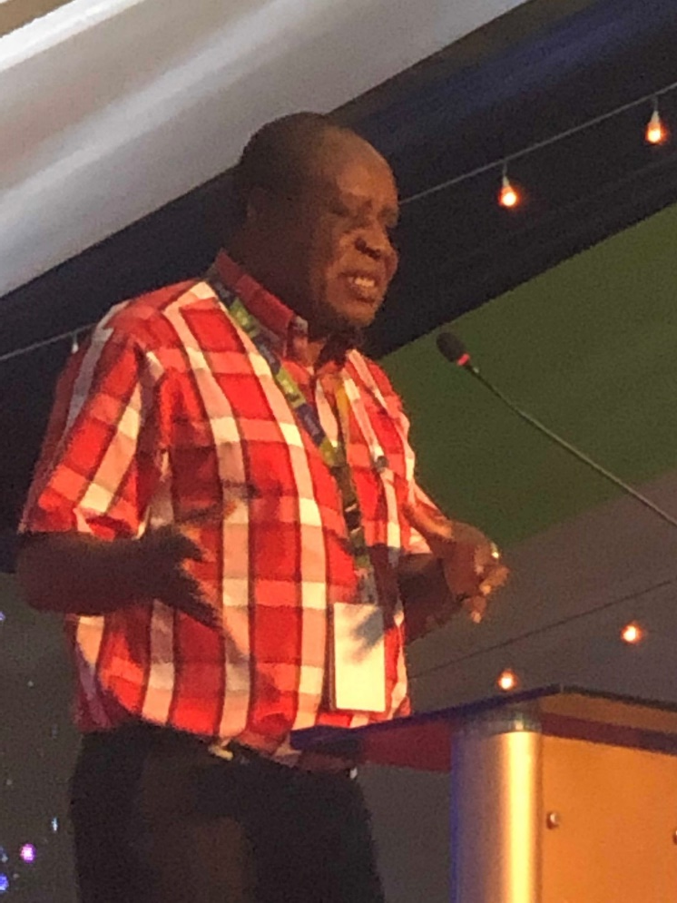
The law of diminishing returns or principle of diminishing marginal productivity
Prof. Laban Aiyiro
Imagine the more you read the more you cant see a positive change. Why?
Notes:
Meaning; when TPAD process increases the teacher’s academic input while the student academic input is fixed, a time will be reached that every additional academic input by the teacher will result in diminishing academic output by the student. This is academically tragic. This book aims at involving the students in the appraisal process not just as reporters of the process flaws but a prime mover.

Slide 16
Burden of Proof
Over the years the teachers have been accused of not teaching effectively.
Tpad is intended to gather evidence of compliance while
Spad seeks to shift the burden of proof to students,
Teachers must get the benefit of doubt
RISK OF BIPOLAR DISODER

Slide 17
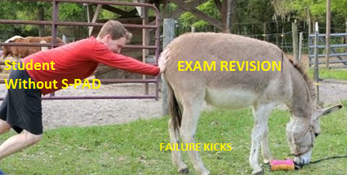

STUDENTS WITHOUT S-PAD THEY ARE VERY HARD WORKING
PUSHING UNWILING DONKEY TO THE RIVER

Slide 18
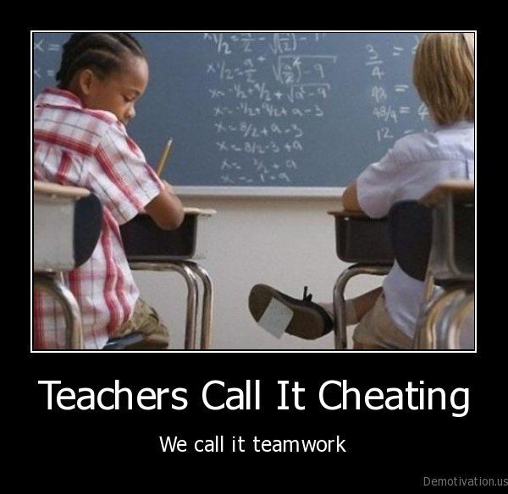

Slide 19
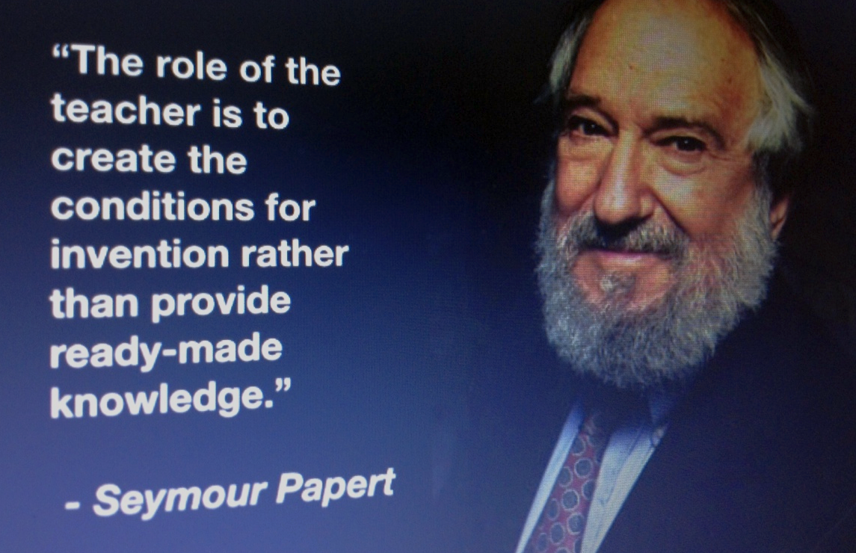

STUDENTS INVOLVEMENT is The Game Changer

Slide 20
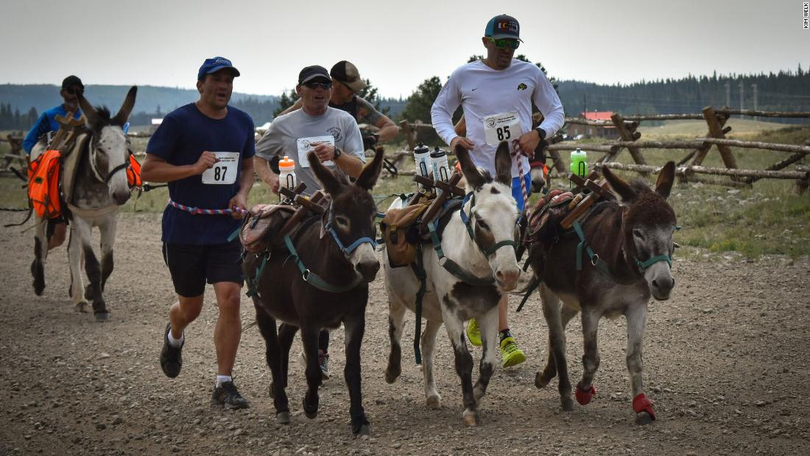
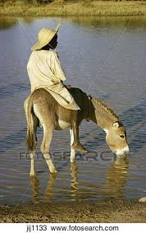
Spaded Student Are Willing Participants in The Race To Win The Mini-score
STUDENTS WITH SPAD ARE SMART WORKING

Slide 21

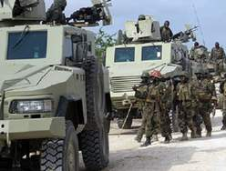
Student Involvement in fighting illiteracy in Kenya
The Student Leadership Organizational Structure
is borrowed from the military
formation of ranks.
Secondary youths are known to enjoy military movies and
attire.
Notes:
its noteworthy that Military world over is known for discipline and order, an aspect quickly fading among the youth.

Slide 22


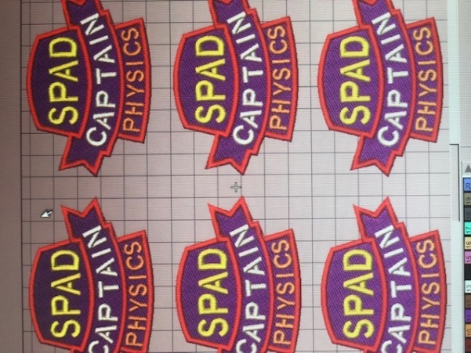
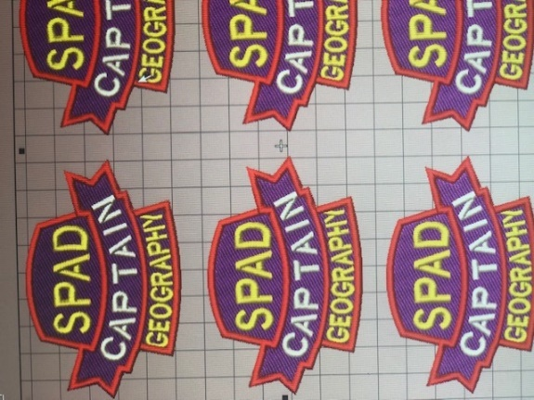
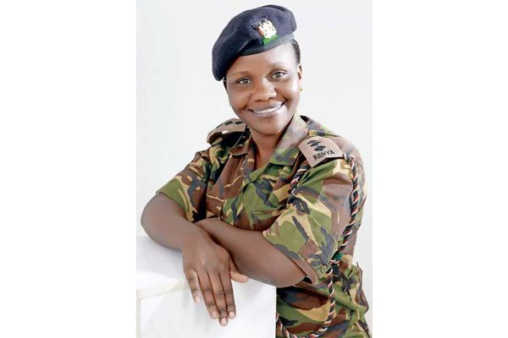
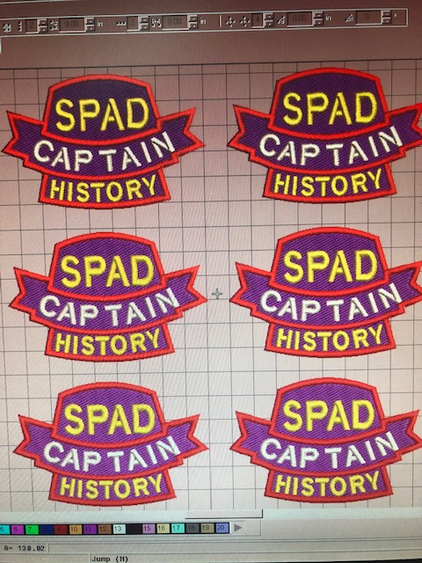

The Strategy Of Reducing The Academic Tail
Chief Spad Commander
Spad Commanders
Spad Class Brigadiers
Spad Captains
Spad Lieutenants
President Uhuru Kenyatta Appoints The First Woman Brigadier
Colonel Fatuma Ahmed to the rank of a Brigadier,

Slide 23
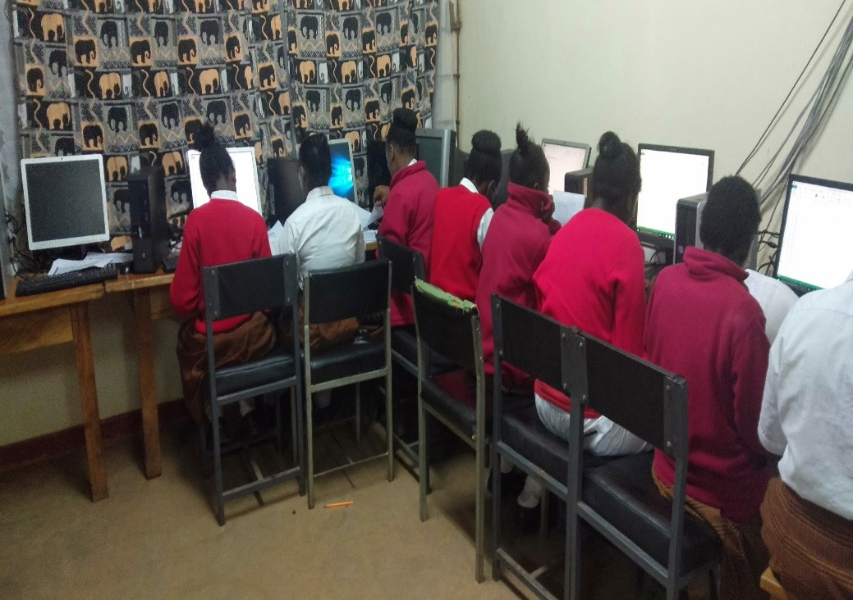
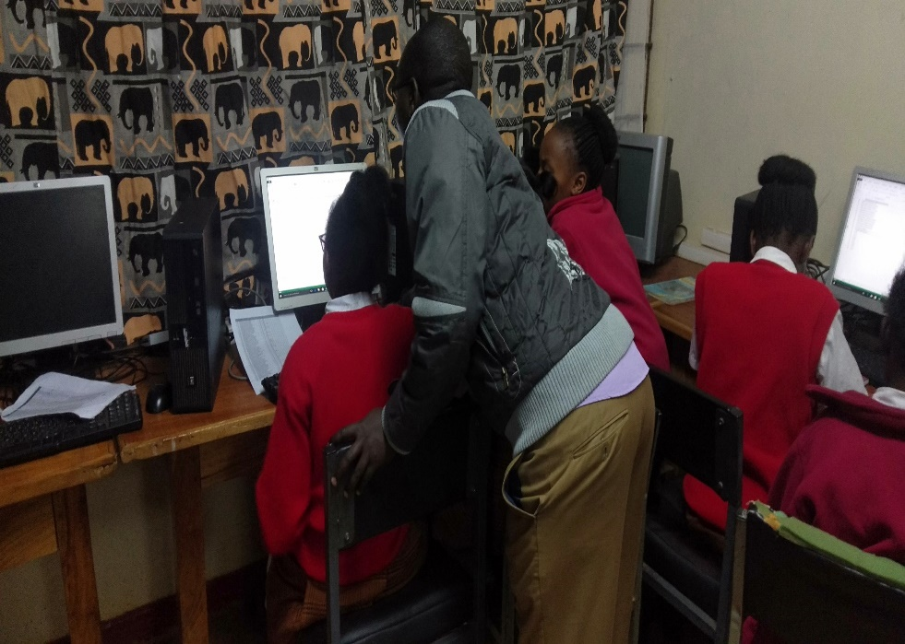

ANALYSIS OF SPAD CATs

Slide 24
Sample of analysed peer CAT exams
SPAD RESULTS SEASON 1.xlsx

Slide 25
RE: APPOINTMENT OF THE 7 SPAD COMMANDERS
SPAD CHIEF COMMANDER AND Coordinator: Strategies Of Academic Improvement And Development
SPAD PARADE COMMANDER And Coordinator: Time Management
SPAD _____ COMMANDER And Coordinator: Learners’ Knowledge And Value Addition
SPAD FORM ONE COMMANDER AND ALSO Coordinator: Promotion Of Co-curricular Activities
SPAD FORM TWO COMMANDER AND ALSO Coordinator: Personal Safety, Discipline And Students Conduct
SPAD FORM THREE, COMMANDER AND ALSO Coordinator: Learning Activity, Innovation And ICT Integration
SPAD FORM FOUR, COMMANDER AND ALSO Coordinator: Collaboration With Parents And Stakeholders

Slide 26
Appointment of Commanders, Brigadiers and Captains
The Brigadiers and Captains are appointed by the Academic Council
This is because if the appointment is left to the Subject teacher, then the subject teachers would end up choosing the same student to be in charge of all the subjects instead of one student per subject.
No student should be a captain of more than one subject.
The appointments are reviewed every term.

Slide 27
Duty of Spad Commanders
Check the Academic work of the Brigadiers
Report to the principal every day
Always be getting the CAT results and keep a copy in your file for brigadiers and captains to refer to when setting targets
Ensure Tittles are adopted and written as follows

Slide 28
DUTIES of Spad Class Brigadiers
Ensure captains do their work effectively and with high levels of discipline.
Check and rubber stamp the notes of all captains.
Attend the academic improvement meeting scheduled by the academic council
Set progressive class target in consultation with captains
Identify the students with overall grade of E and develop a program for them.
Ensure the E students get a warning letter
Take the roll call for all preps, Rescheduling and remedial lessons.
Prepare a Broadsheet from the marks presented by Captains
Check Church attendance Cards

Slide 29
Duties Of Spad Captains
Go for the teacher from the staffroom if 5 minutes late
Note in the exercise book the time the lesson started.
Checking and rubberstamping the notes of fellow students in their subject area.
Identifying the E students and assigning them Subject lieutenants to assist them by giving and marking assignment.
Attend the academic improvement strategy meeting scheduled by the principal once in a week.
Liaise with the brigadier to analyse the CAT.
Report to the teachers/d. principal any case of academic indiscipline; the one affecting the subject performance.
Ensure that students revise past papers and sign at the back of the exercise book.
Be the custodian of the subject syllabus and ensure you know the coverage level.
Check the micro notes
Present the Mark list to Brigadier after peer CAT

Slide 30
Subject Spad Lieutenants
This a termly duty given by the subject captain to a student to give particular student peer tuition to low performing student in order to boast the subject mean score.
The first assignment is to eliminate the E, then D- followed by D.
The level of elimination will depend from the school entry behavior and particular subject.
To revise the CAT then give the mentored and mark, repeat until 70% is attained

Slide 31
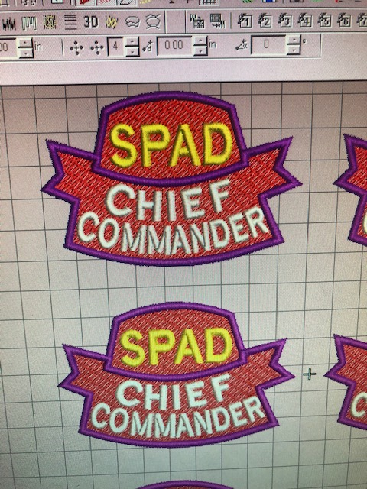
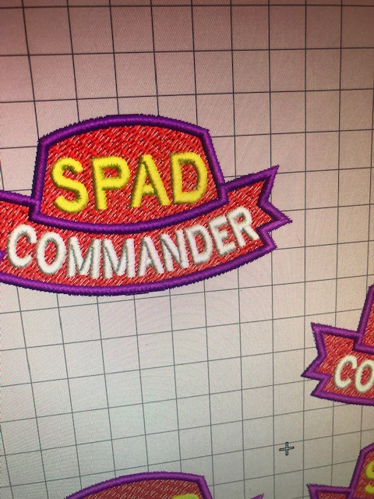
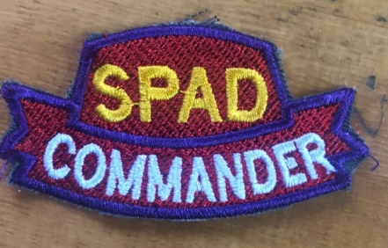

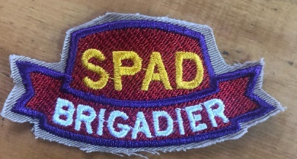
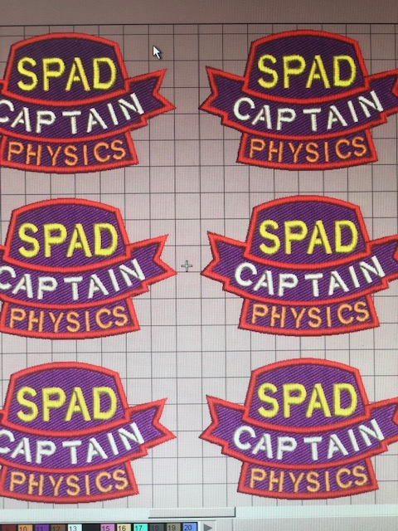
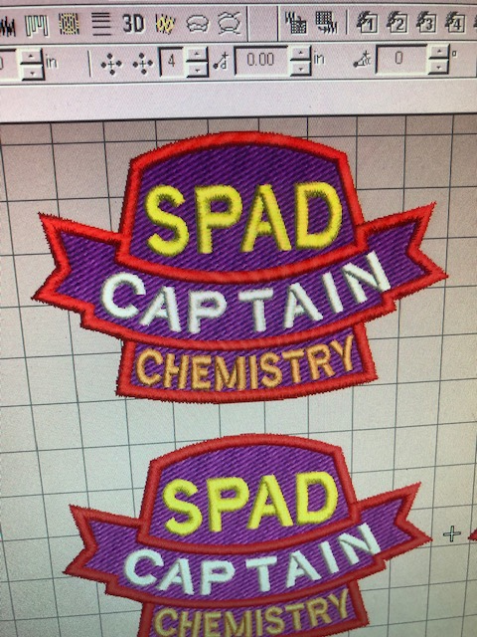
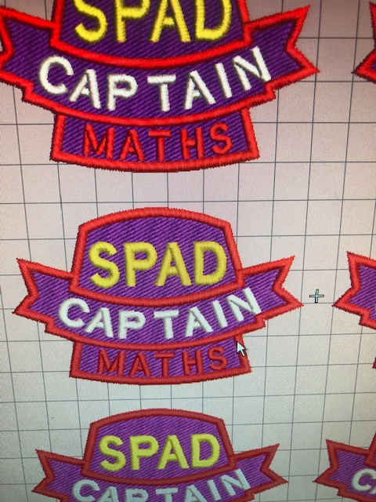
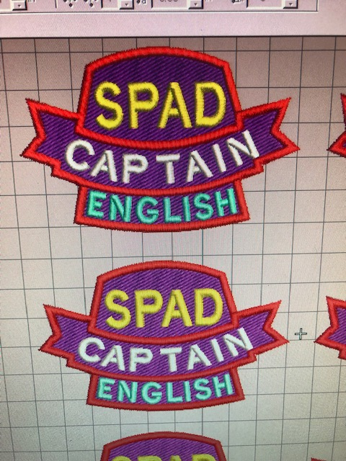
SPAD BADGES & RANKS
4 Streams
CLASS
SUBJECT

Slide 32
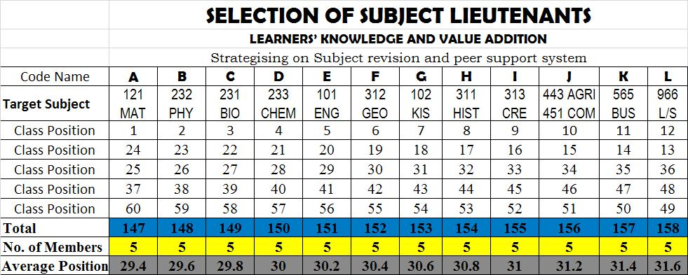
Example of the formation of study groups Page 20

Slide 33
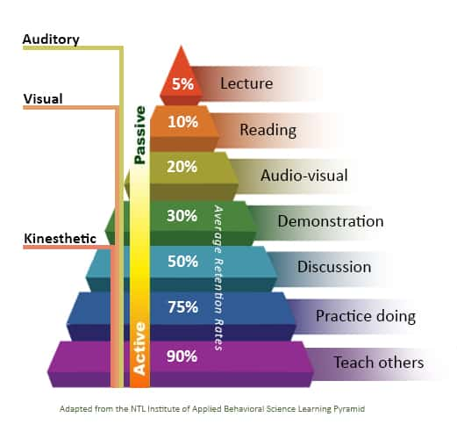
The Learning Pyramid

Slide 34
PEER CAT INSTRUCTIONS
Name,_______________ Admission Number, ____ Date, _______
Peer CAT No ______ Previous peer CAT marks ________ Target _____
Syllabus Coverage % _______ My Lieutenant_____ Sign____________
The Peer CAT shall start as specified
half of the questions shall be from week’s lesson and some from past papers
The Subject captains sets and marks the CAT, the Brigadier is in charge of coordination and reports to the principal.
The signed list of the candidates must be submitted to the principal after the peer CAT

Slide 35

Objectives: PEER CAT
The Students To Revise,
Reduce Time Wastage During Free Time,
Enhanced Team Work
Formation Of Study Groups And
Reduce The Academic Tail.
There is one thing stronger than all the armies in the world, and that is an idea whose time has come.

Slide 36
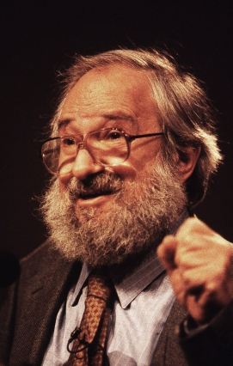

“I am convinced that the best learning takes place when the learner takes charge of their own learning” Seymour Papert

Slide 37

And the things that thou hast heard of me among many witnesses, the same commit thou to faithful men, who shall be able to teach others also (2nd Timothy 2:2)

Slide 38
STRATEGISE TO IMPLEMENENT SPAD
Life Skills Lesson
CAT one marks
Motivation
Results announcement by students
Badges
Spad Book for Captains
Trips
Result Banner
Target and Strategies projects

